Slide 1

Automated Attendance System
Streamlining Campus Operations with Intelligent Solutions
Developed by Pratham Desai
Notes:
1

Slide 2



The Challenge: Manual Attendance Bottlenecks
Traditional attendance methods burden educators and administrators, leading to:
Time-Consuming Process
Prone to Human Error
Lack of Data Insights
Significant class time lost to roll calls and record-keeping.
Manual entry often results in inaccuracies and discrepancies.
Difficulty in generating meaningful attendance analytics for intervention or reporting.
Notes:
2

Slide 3


Our Objectives: Empowering Education
The Automated Attendance System aims to:
Automate attendance capture to save valuable time.
Provide comprehensive analytics for teachers and administrators.
Simplify attendance tracking and leave applications for students.
Enhance overall efficiency and transparency in academic operations.
Notes:
3

Slide 4



Key Features: Tailored for Every User
For Students
Real-time attendance tracking dashboard.
Seamless leave application submission and status updates.
Automated notifications for attendance thresholds.
For Teachers
Intuitive heatmap visualisation of class attendance patterns.
Comprehensive overview of class attendance records.
Effortless attendance data export for reporting.
For Administrators
Robust user management for students and teachers.
Streamlined leave application approval workflow.
Centralised attendance reports for institutional oversight.
Notes:
4

Slide 5




Under the Hood: Our Robust Technology Stack
Our system is built on a modern, scalable, and secure technology foundation:
Frontend: React
Backend: Flask/Python
Dynamic and responsive user interfaces.
Powerful, lightweight, and efficient server-side logic.
Database: MongoDB
Deployment: Render
Flexible, scalable NoSQL database for efficient data storage.
Seamless and reliable cloud hosting for continuous availability.
Notes:
5

Slide 6
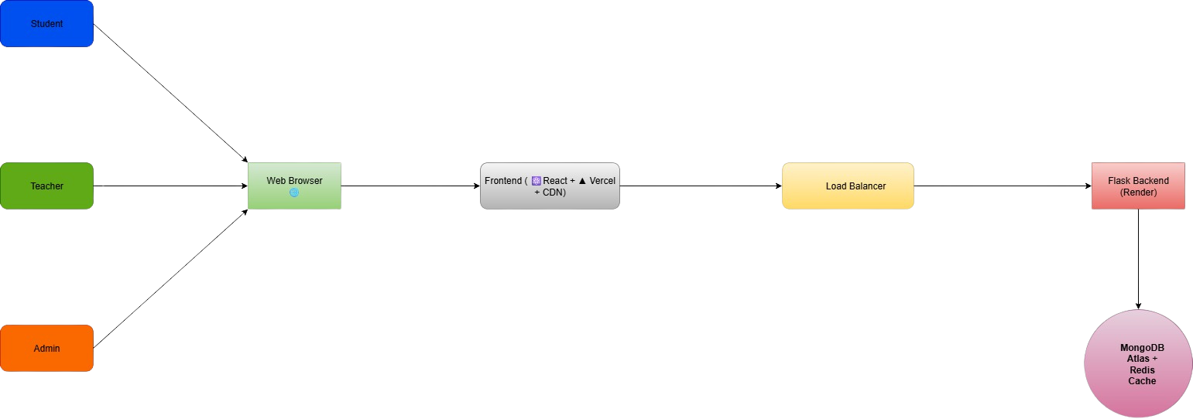
System Architecture: A Cohesive Ecosystem
The diagram below illustrates how our system components interact to provide a seamless experience.
Notes:
6

Slide 7
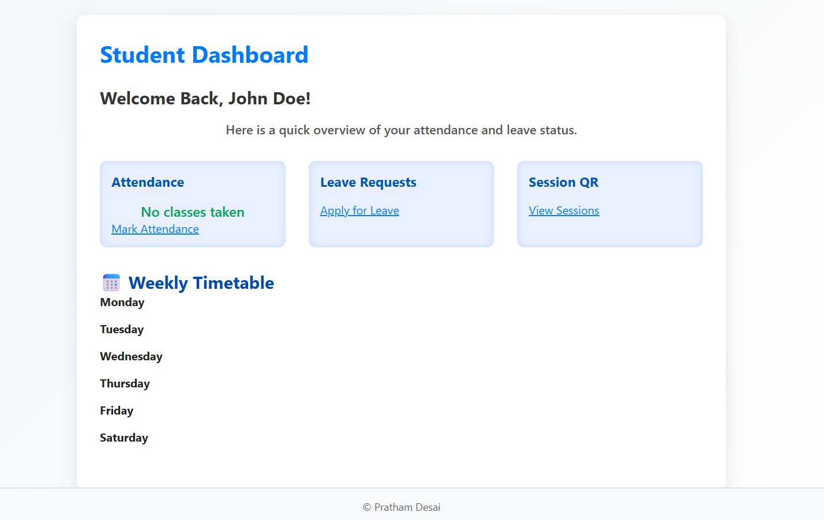
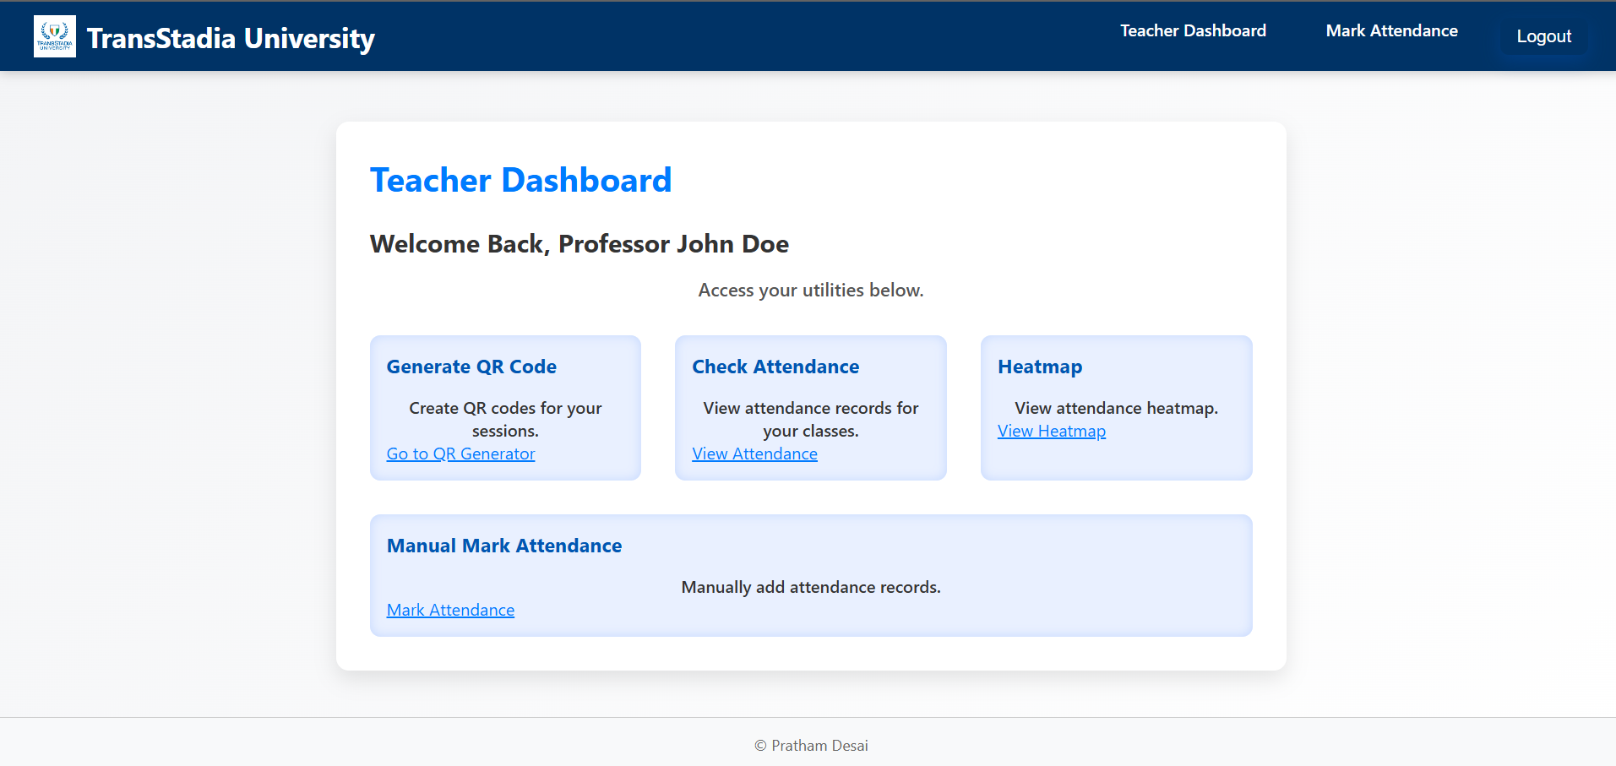
User Experience: Sneak Peek
Get a glimpse of the intuitive interfaces designed for each user role, prioritising ease of use and clarity.
Notes:
7

Slide 8

Unlocking Benefits: Why Automate?
The Automated Attendance System delivers significant advantages:
Enhanced Accuracy: Eliminates manual errors, ensuring precise records.
Increased Automation: Frees up staff time for more critical tasks.
Easy Access: Information is readily available to all authorised users.
Real-Time Updates: Provides instant insights into attendance status.
Improved Insights: Data-driven decisions for better student support.
Notes:
8

Slide 9



The Road Ahead: Future Enhancements
Our vision extends beyond the current capabilities, incorporating cutting-edge technologies for even greater impact.
Mobile App Integration
AI-Based Attendance
Dedicated mobile applications for both students and faculty for on-the-go access.
AI-Powered Chatbot
Integrating facial recognition for touchless and highly accurate attendance capture.
For instant FAQ support and attendance queries for students.
Notes:
9

Slide 10

Thank You
For your time and consideration.
Designed & Developed by Pratham Desai
prathamdesai625@gmail.com
Notes:
10

